Slide 1
BOP-Day 3

Slide 2


Business Owners Program Domain KT for Progressive Team
Day 3

Slide 3
Day | Topics | Subtopics
1 | Concept | Meaning
 |  | Advantages
 |  | Eligibility Rules and its need
 |  | BOP Vs CPP
2 | Coverages | Commercial Property Insurance (BOP Vs CPP)
 |  | General Liability Insurance
 |  | Business Interruption Insurance
 |  | Business Interruption Insurance
3 | Exclusions Endorsements Additional Coverages | What’s Not Covered?
 |  | Extra Expenses
 |  | Inland Marine
 |  | Equipment Breakdown
 |  | Spoilage
 |  | Employee Theft
 |  | Etc.
4 | BOP Rating & Premium Guidelines | Rating factors
 |  | Premium Guidelines
 |  | What Does a BOP Cost
 |  | Average Cost of a BOP
5 | BOP Policy issuance | BOP Policy Forms
 |  | Input Forms Output Forms
 |  | Valuation Methods
 |  | Policy Issuance Flow
 |  | Case study & Discussion- A snapshot at a Restaurant looking for insurance
 |  | Sample Policy
 |  | Declaration Page- A snap shot
 |  | Declaration Page- A snap shot
6 | Claims Handling | Property Damage Assessment and
 |  | Recovery for Business Owners
 |  | Filing a claim
 |  | Documents Required for Claim Process
 |  | Claims Flow Process

Slide 4
Exclusions Endorsements Additional Coverages | What’s Not Covered?
 | Extra Expenses
 | Inland Marine
 | Equipment Breakdown
 | Spoilage
 | Employee Theft
 | Etc.

Slide 5
Let’s quickly look the specific items that are covered/ protected in Property and Liability coverages and then move to the items that are not covered or excluded.

Slide 6
Coverages - Property
Buildings
Structure mentioned at the location
Completed additions
Fixtures (including outdoor fixtures)
Permanently installed – machinery and equipment
Personal property in apartments
Personal property owned to maintain/service the building
Construction equipment and supplies – within 100 feet of the described premise (if not covered by any other insurance)
Notes:
Difference between 1st party and liability coverage
Buildings (Structure mentioned at the location), completed additions, fixtures (including outdoor fixtures, permanently installed – machinery and equipment, personal property in apartments, personal property owned to maintain/service the building, construction equipment and supplies – within 100 feet of the described premise (if not covered by any other insurance))

Slide 7
Business Personal Property (inside the premise or within 100 feet of the premise)
Property owned and used for business
Other’s property used for your business
Property within your contractual liability
Notes:
Business Personal Property (inside the premise or within 100 feet of the premise) – property owned and used for business, other’s property used for your business, property within your contractual liability

Slide 8
Additional property coverages
Optional coverages
Debris removal
Preservation of property
Fire department service charge
Collapse
Water damage and other liquids
Business income
Extended business income
Extra expense
Pollution cleanup and removal
Civil authority
Increased cost of construction
Glass expenses
Electronic data
Interruption of computer operations
Employee dishonesty
Money and securities(special form) or burglary and robbery (named peril form)
Forgery
Interior/exterior glass
Outdoor signs
Mechanical breakdown
Money orders and counterfeit paper currency
Computer coverage
Accounts receivable
Valuable papers and records
Notes:
Additional property coverages – Debris removal, preservation of property, fire department service charge, collapse, water damage and other liquids, business income, extended business income, extra expense, pollution cleanup and removal, civil authority, increased cost of construction, glass expenses, electronic data, interruption of computer operations
Automatic seasonal increase in amount of insurance – the business personal property limit automatically increases by 25 percent provided the insured carries insurance equal to 100 percent of its average monthly property (for 12 months preceding the loss)
Business income and extra expense included – Coverage is automatically included with a dollar (100% of the personal property insurance limit) or time limit (business income and extra expense for 12 consecutive months after the occurrence)
Other property type coverages included or available as options – Employee dishonesty, money and securities, forgery, interior/exterior glass, outdoor signs, mechanical breakdown, computer coverage, accounts receivable, valuable papers and records

Slide 9
Coverage extensions
Newly acquired or constructed property
Personal property off premises
Outdoor property

Slide 10
Coverages - Liability
Bodily injury and property damage liability
Premises and operations
Products and completed operations
Liability assumed under a contract
Personal and advertising injury liability
Medical payments coverage (paid regardless of fault)
Some BOPs automatically provide Professional liability coverage for some professions e.g. retail drugstores
Hired and non-owned auto liability coverage can be added without having to purchase a separate business auto policy
Limit of liability is defined for - each occurrence, general aggregate and products/completed aggregate limit
Supplementary payment is provided for cost of bail bonds (up to $250), loss of earnings ( $250 per day), prejudgment interest etc.

Slide 11
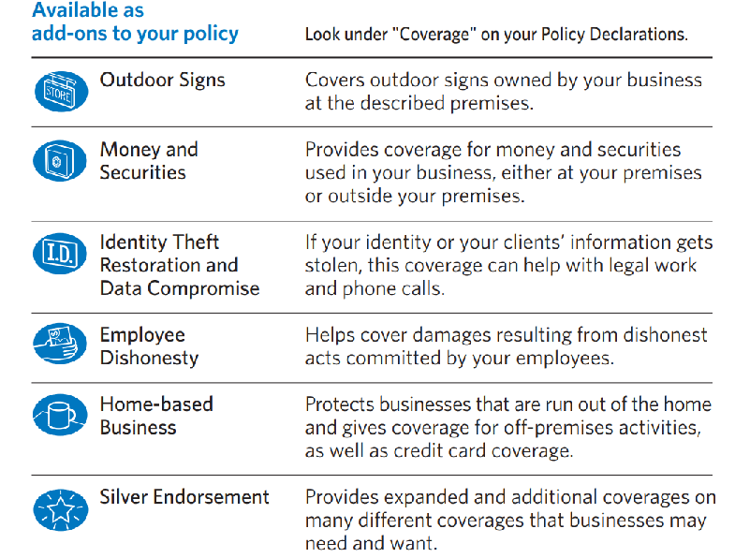
BOP Endorsements
All State BOP as an Example
Endorsements are added to the main policy for extra premium as an extra protection bought.

Slide 12
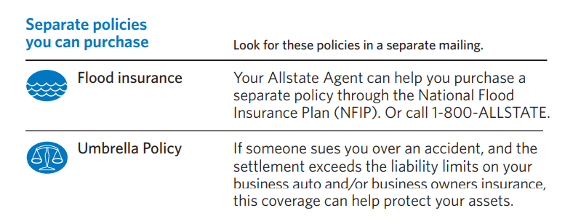
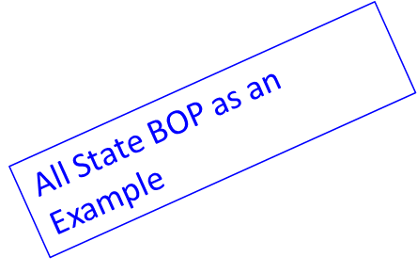
BOP Additional Coverages
Additional coverages are stand alone coverages. These coverages are attached on top of the existing policy to fill the gap and make it comprehensive

Slide 13
Common exclusions
Common exclusions depend on the coverage form chosen
Basic and broad forms generally exclude
Ordinance or law, earth movement, government action, nuclear hazard, war, mechanical or electrical breakdown and steam boiler explosions, nuclear damage, war etc.
Special form generally excludes
Common exclusions include wear and tear, rust, corrosion, decay, mechanical breakdown, loss or damage to products etc.

Slide 14
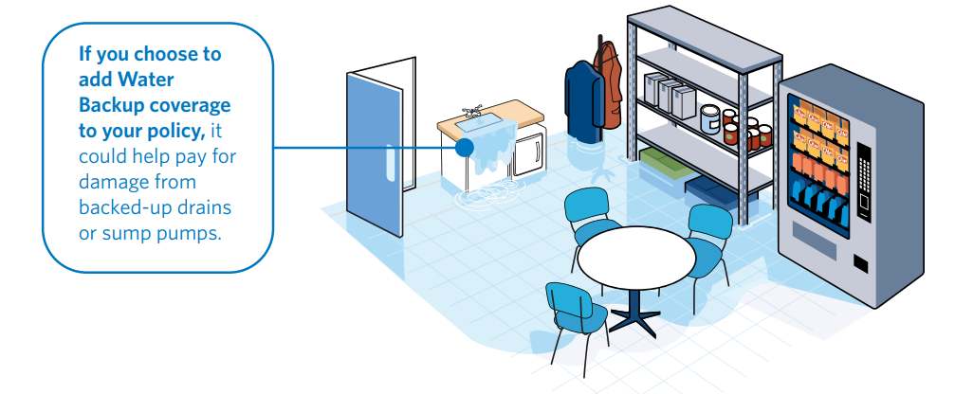
What’s Not Covered?
Generally, BOPs do NOT cover :
1. Professional liability (Errors & Omissions),
2. Auto insurance,
3. Worker's compensation or health and disability insurance.
Business owners' insurance protects your business from accidental and sudden losses. However, some losses aren’t covered.
Equipment breakdowns in the business.
Basic equipment maintenance and repairs are not covered. However, if equipment is damaged due to a covered loss, yourpolicy would pay to fix it. For example, if your copier breakdown due to an artificially generated current, its repair would be covered.
Floods, earthquakes and water backup.
Floods, earthquakes and water (sewer) backups are typically excluded from business owners insurance. If you want to purchase additional insurance to cover these events, talk to your local Agent

